Slide 1
EARTH WITHOUT POLLINATORS WOULD BE A BORE

Slide 2
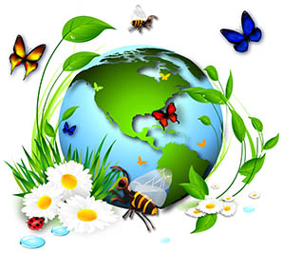
WHAT IS BIODIVERSITY?
Bio: means life
Diversity: means variety
Biodiversity = variety of life
POLLINATORS ENCOURAGE LOTS
OF VARIETY OF LIFE!
Notes:
How can we figure out the meaning of the word “biodiversity?”
Well, if you look at the word and separate it into two parts, then you get bio and diversity.
Bio means life, does anybody know what diversity means?
Does anybody know what variety means?
Do we have a lot of the same type of animals/plants on the Earth or do we have a lot of different types?
We have a very biodiverse planet!

Slide 3
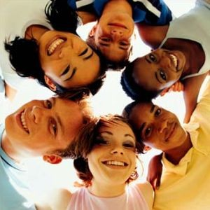
WHAT IS BIODIVERSITY: Exploring Genetic Diversity
Look around the room, and observe the differences and similarities you share.
This is called GENETIC DIVERSITY
Notes:
Genetic biodiversity allows plants and animals within the same species to be different.
Think about dogs, are they all the same?
What are some differences between different kinds of dogs?
Now, turn to the person sitting next to you. Do you look exactly the same?
No, we do not, because there is a lot of genetic biodiversity within every species of animal. This is important because it increases the likelihood of survival.
How do we get genetic biodiversity? From our Genes!
Genes, and not the type you are wearing, are what makes us all different! These kinds of genes are inside tiny little cells and tell your cells what you’re going to be like.
Where do you get your genes? From your parents.
Can you think of something you have in common with one of your parents? Or maybe a brother or sister? Genes also come into play with bees! There are over 20,000 different types of bees, not just honeybees!

Slide 4
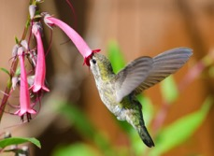
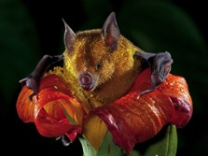
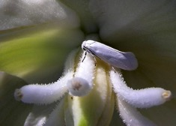
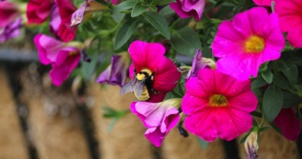
WHAT IS BIODIVERSITY: Ecological Diversity
VARIETY OF HABITATS within an ecosystem that supports a large variety of lives.
A habitat includes: food, water, and shelter.
An ecosystem is a group of different habitats supporting each other.
Notes:
Show the students the POLLINATOR POSTER
1.How many different things do you see in these pictures? Do we have one living thing in these pictures or multiple? When lots of different species live together in one place, is that genetic or ecological biodiversity? (Ecological)
2.Now look at the butterflies, do you notice any differences between them? When two animals are the same, but look different, do we say they have genetic biodiversity, or ecological biodiversity? (genetic biodiversity)
3.Do you see any food in this picture? What type of plants provide food for you that you like to eat? What type of fruit do you like to eat? Plants provide a lot of food for us, and pollinators help plants grow that food. Plants and animals living and working together is made possible by what? (Biodiversity)
An ecosystem consists of many different habitats, which support many different living things that support each other in life. An ecosystem is complete when there is food, water, and shelter for all living creatures living within that system. Healthy soil, clean water, and diverse plant species are all elements of a basic ecosystem. Think about your school. You have students, teachers, principals, janitors, a librarian, etc.
What would happen if you took away the teachers?
What if the janitors disappeared, what would happen then?

Slide 5
HOW DOES BIODIVERSITY WORK?
Soil to plant to air picture followed by group cup activity 10 min
Notes:
Cup has multiple sticks in it. The cup consists of life, all of the things are trying to live. What is a shredder? What is a pollinator?
All of these things need habitat. What are three things all habitats need? 1. water 2. food 3. shelter
Ask students to observe what happens when one living thing takes a little more resources from the system?
What happens when habitats or whole ecosystems are destroyed? What happened to the cup? Did it stay balanced? Did anything fall out of the cup?
What happens when several pieces of the ecosystem/habitat go away?
What happens to the things that feed on plants if the plants are not surviving?
Imagine if we added more habitats to this system, what would happen to the heavy cup, would it rise or fall?

Slide 6
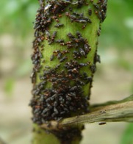
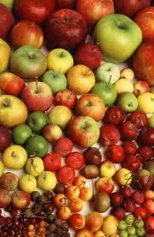
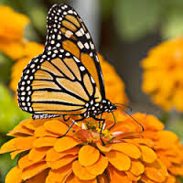
WHY IS BIODIVERSITY IMPORTANT?
Provides a variety of foods and resources.
Defends against diseases and pests.
Provides ecological services, such as:
POLLINATION!
Notes:
Ask students questions as a group. For older students, you could also break them into small groups and let them discuss the answers.
How does one plant produce another plant? (Through pollination)
Can they do it alone or does something else have to help? (Something has to help, we call these pollinators)
What makes bees and other pollinators visit flowers? (the bright colors and they are looking for food, which we can nectar)
What is pollination? (Pollen mixes with a plant egg and makes a seed)
What do we usually do with seeds? (Plant them in the ground, give them sunlight and water)
What happens when a seed is planted in the ground? (Plants make more plants.)

Slide 7
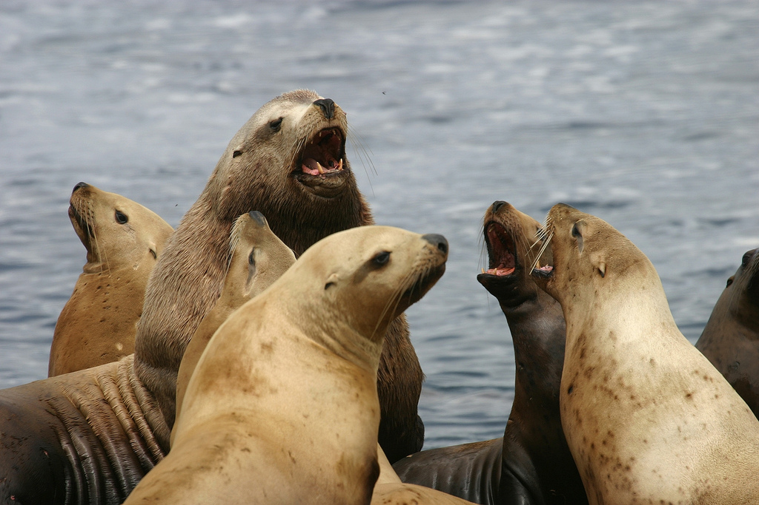
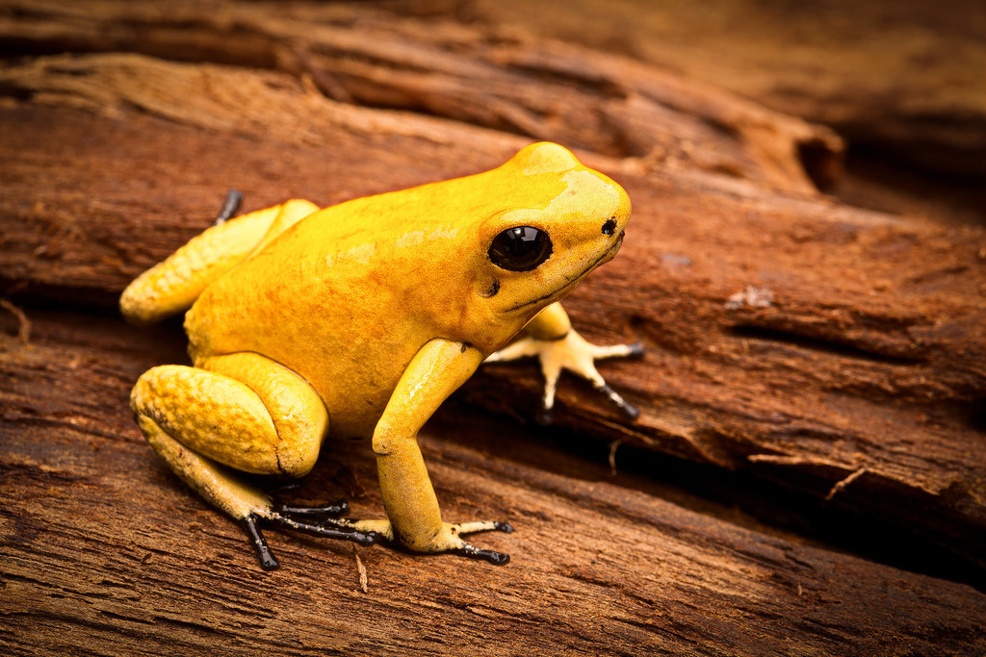
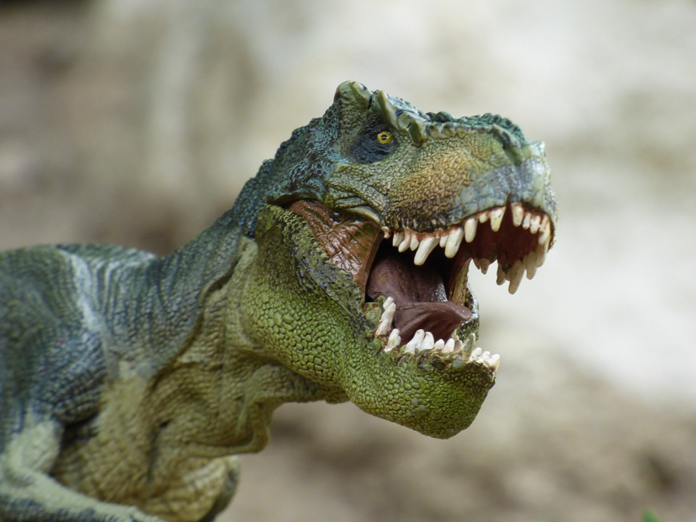
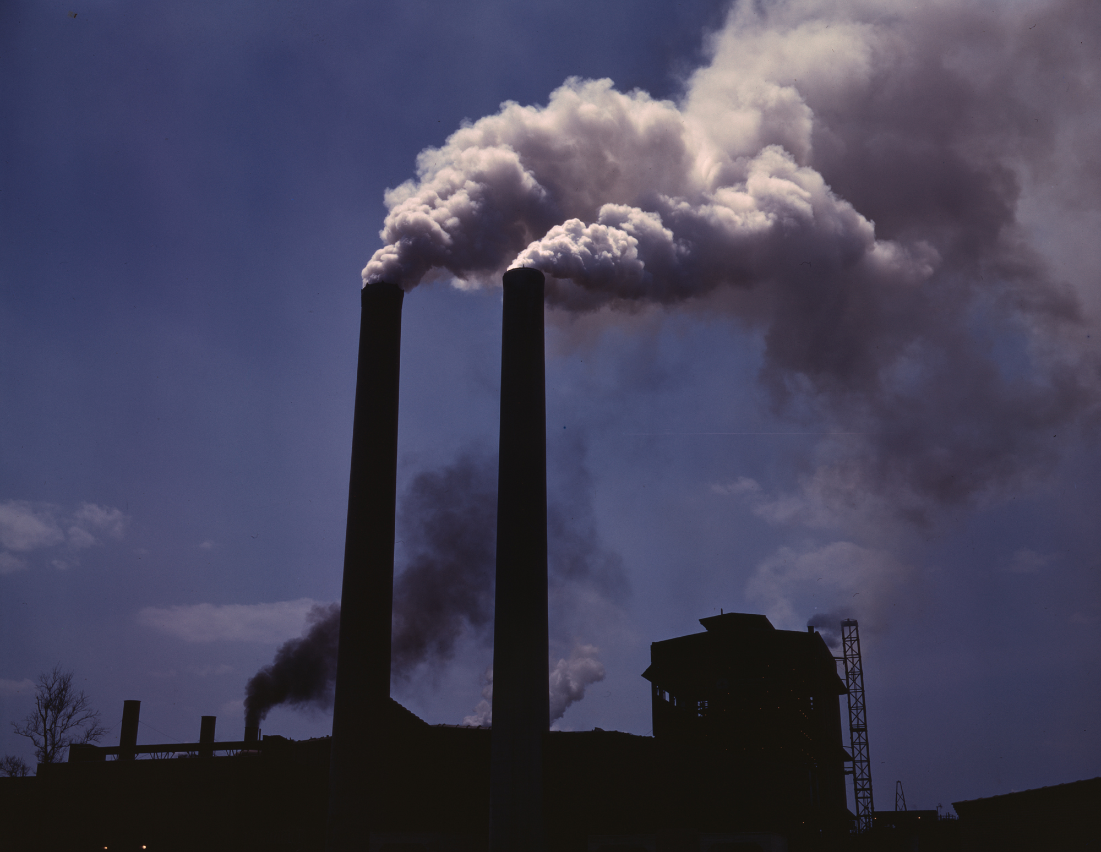
THREATS TO BIODIVERSITY
Imbalance
Extinction
Today, 1/3 of all known species are threatened with extinction!
Loss of natural habitat
Spread of non-native species and diseases
Climate Change
Pollution
Notes:
Do you know what it is called when a group of animals dies off completely? (extinction)
Can you name a group of animals that this has happened to?

Slide 8
WHAT IS POLLINATION?
The transfer of pollen from one plant to another, resulting in seeds, food, and more plants.
Notes:
Have you ever heard of pollination/pollinators?
What does pollen look like?
What is pollination?
Pollen mixes with a plant egg and makes a seed.
Does anybody know how seeds work?
What do you do with seeds?
What happens when a seed is planted in the ground? Plants make more plants.

Slide 9
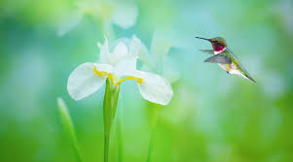
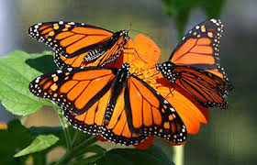
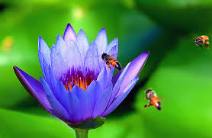
POLLINATION AS AN ECOLOGICAL SERVICE
WHAT IS AN ECOLOGICAL SERVICE?
Pollination is an example of an ecological service provided by many different groups of animals, including insects and birds, that supports many lives on Earth by providing food and other resources.

Slide 10
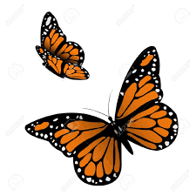
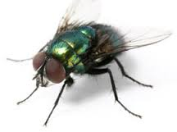
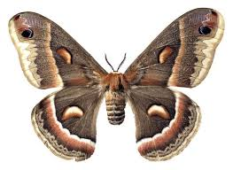
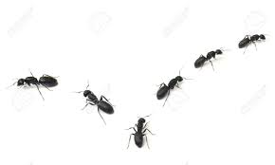
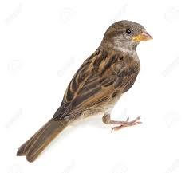
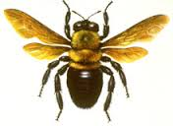
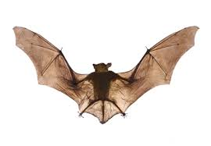
WHO ARE THE POLLINATORS?
Wasps
Bees
Butterflies
Moths
Flies
Bats
Beetles
Ants
Birds
Reptiles
And the list goes on, many different species take interest in flowers!

Slide 11
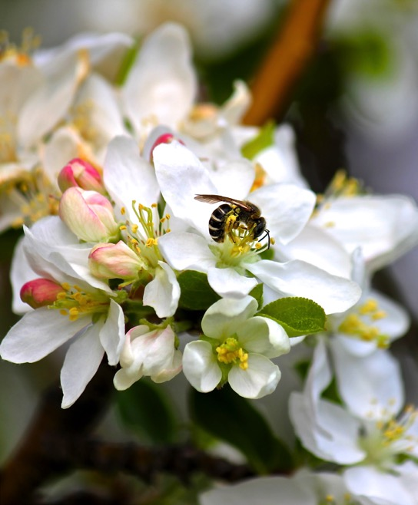
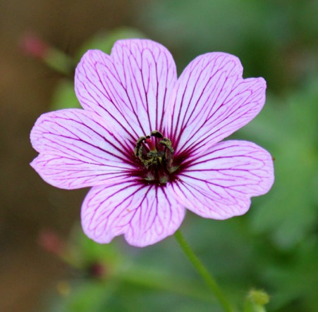
CAN YOU SEE THE POLLEN?
Notes:
Do you see my favorite type of pollinators? What are they? (Bees)
What’s inside the flower that the bee likes? (Nectar, which is very sweet. Flowers use the sweetness to their advantage. Flowers are bright and showy, and they know bees like them because of that. They keep the nectar deep inside of them and then pollinators have to go through all of the pollen to drink their nectar.
While the bees are drinking nectar, what else do they come in to contact with in the flower? (Pollen)
How do they transport that pollen to another flower? (It sticks to their body)

Slide 12
Notes:
What is a honeybee? (A bee that makes honey AND pollinates plants)
Will someone share with us a time they saw a honeybee?
Can anyone tell me what you sometimes find inside of fruit? (Seeds) Fruits make more fruit with the help of pollinators.

Slide 13
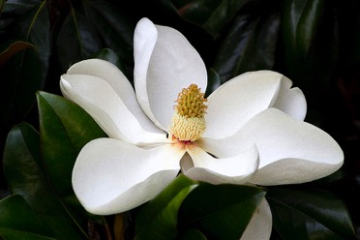
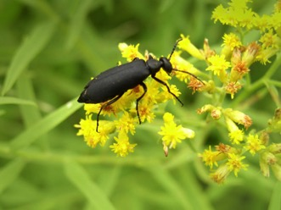
WE NEED PLANTS
Plants provide shelter, food and even clean air.
Flowering plants didn’t always exist, but once they did, our planet became much more diverse in the lives living on it, because more food choices came to exist.
The first pollinator is thought to have been a beetle and the first flower is thought to have looked just like this magnolia.
Notes:
1. The first pollinator was this little bug. Do you guys know what this is/what does it look like?
2. Why is this important?
3. Why do we need to make more plants? Plants provide food, shelter, and guess what else they provide for our lungs? Do you know what our lungs do? They breathe air, plants help create the oxygen we need to live!
90% of Earth’s plants are flowering plants and they depend on pollination

Slide 14
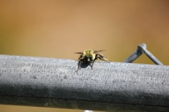
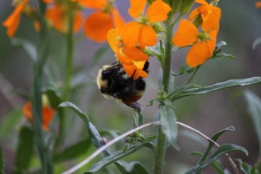
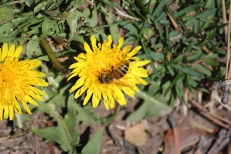
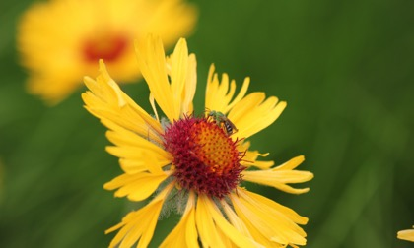
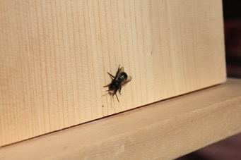
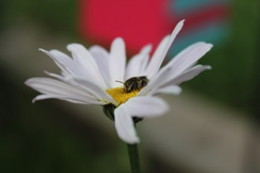
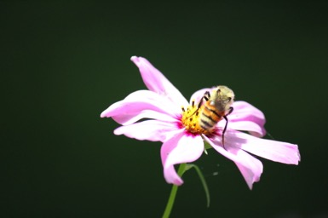
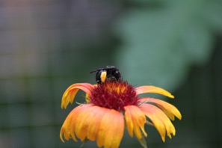
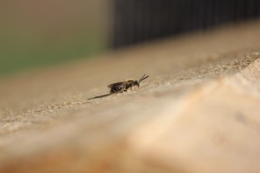
BEES OFFER IMPRESSIVE DIVERSITY
There are 20,000 different kinds of bees on Earth!
Notes:
Does anyone know what a bumblebee is?
Why are they in your garden?

Slide 15
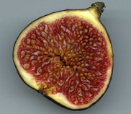
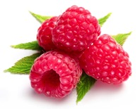
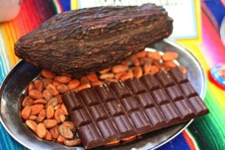
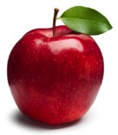
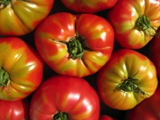
POLLINATORS SUPPORT BIODIVERSITY
90% of all plants flower and benefit from pollinator-assisted pollination, and only 20% could rely on wind pollination alone to reproduce.
80% of the produce we depend on came from pollinator-assisted pollination.
1 in 3 bites of food we eat depends on animal pollination!
Notes:
How many of you like Fig Newton’s? Did you guys know that figs have seeds in them?
Who likes raspberries? Do raspberries have only one seed or are there multiple seeds?
Did you know chocolate came from a plant? It requires pollination as well!
Did you know bumblebees are the best tomato pollinators? How many of you guys like pizza? Tomato sauce on your pizza? Without tomatoes there would be no tomato sauce.

Slide 16
POLLINATORS SUPPORT BIODIVERSITY
Activity showing how pollination supports a variety of lives including us
Puzzles!
Notes:
How many different things do you guys see in the circle of your puzzle?
Can you name all of them?

Slide 17
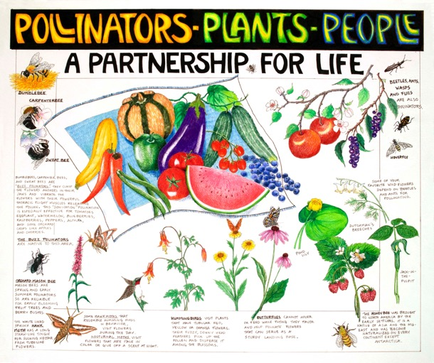
THREATS TO BIODIVERSITY
LOSS OF POLLINATORS!

Slide 18
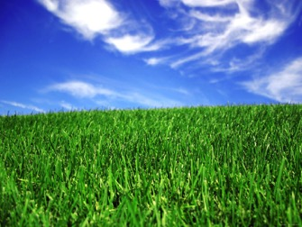
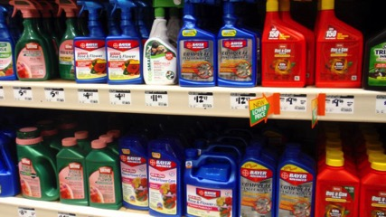
POLLINATORS ARE STRUGGLING
Loss of habitat
Lack of food (flowering plants)
Use of pesticides (toxic chemicals)

Slide 19
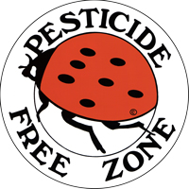
PESTICIDES
INCLUDE:
Insecticides: targets insects (remember the list?)
Herbicides: targets weeds (includes many flowers)
Fungicides: targets fungus (disrupts soil health)
Pesticides get into the soil, drinking water, and food of animals living where the chemicals are used.
Notes:
When we spray something that kills insects, what do you think happens to the pollinators? (It kills them too because they are insects)
How does spraying pesticides on weeds above ground affect the soil and the bugs under the soil? (The chemicals go in to the ground and hurt the bugs and soil, many of which we need to produce food)
What does this do to biodiversity? (It reduces it, because it kills off certain species)

Slide 20
WE DON’T NEED PESTICIDES TO CONTROL PESTS! THINK NATURAL!

Slide 21
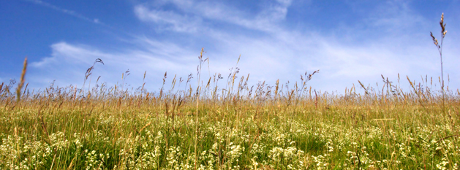
FEED THE SOIL: BIODIVERSITY BELOW THE GROUND
Disturb it less
Plant diverse plants
Keep living roots in it
Keep the soil covered
Notes:
Have you heard of predators?
What do they do?
Do you guys get the idea that everything is interconnected?

Slide 22
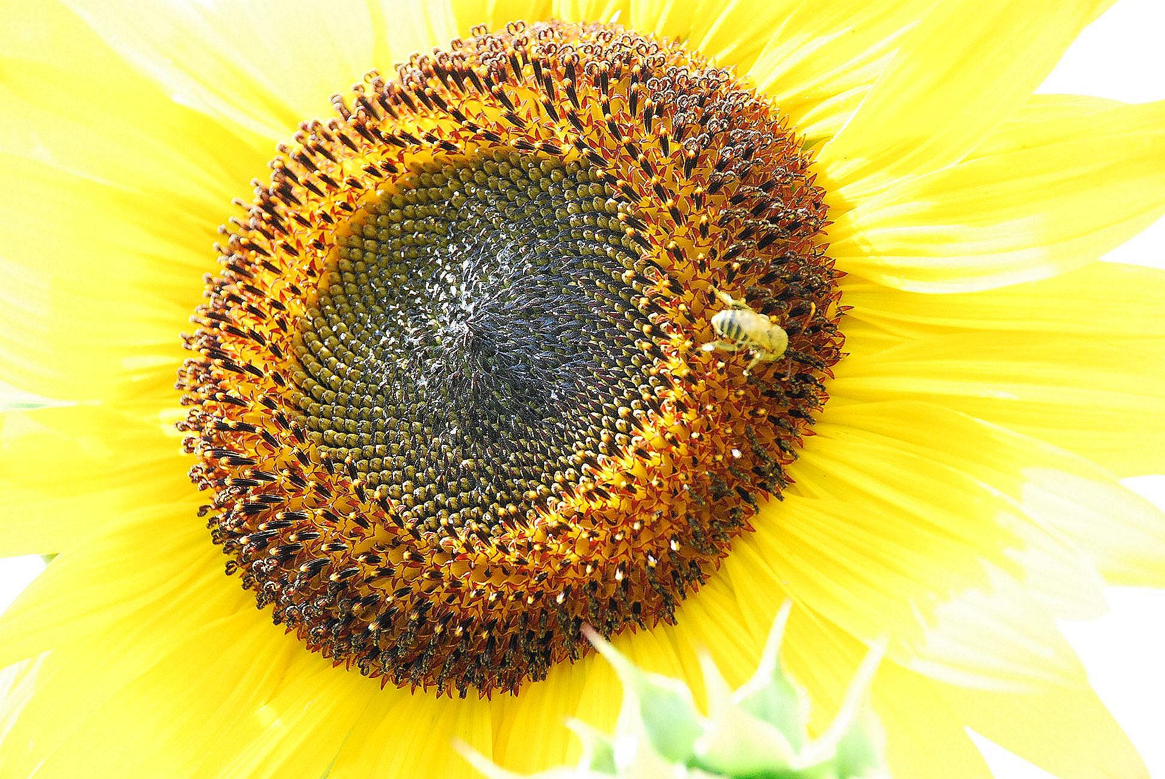
PUT HABITAT BACK: BIODIVERSITY ABOVE THE GROUND
Plant pesticide-free bushes and trees (shelter)
Leave some open soil under bushes and trees (shelter)
Place bird, bat, and bee houses (shelter)
Plant organic fruit-producing plants (food)
Plant organic native wildflowers that bloom at different times during the growing season (food)
Provide a source of water
Notes:
1. Who remembers what biodiversity means?

Slide 23
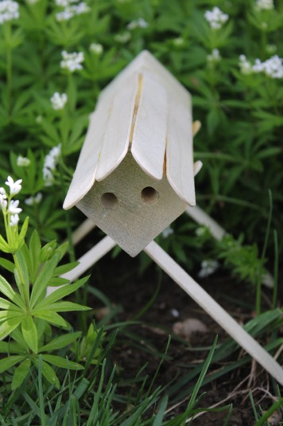
BUILD YOUR OWN NATIVE BEE HOUSE!
Notes:
Can someone explain to us how pesticides affect biodiversity? (They kill off insects, which reduces overall biodiversity)
What is an alternative for using pesticides? (Growing things organically, making sure there are bigger animals to eat little bugs, focusing on healthy soil)

Slide 24
LEAFCUTTER BEE
Notes:
These bees will live inside the bee house we are about to build!

Slide 25
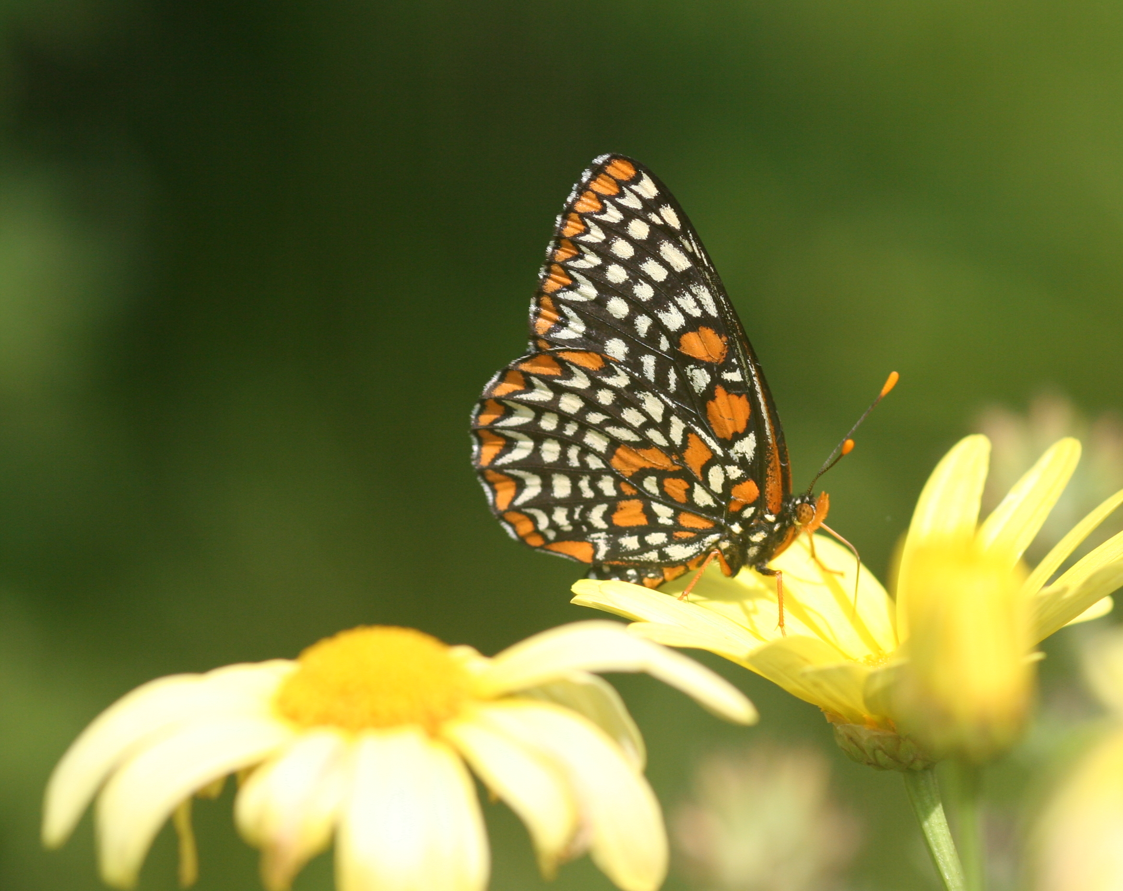
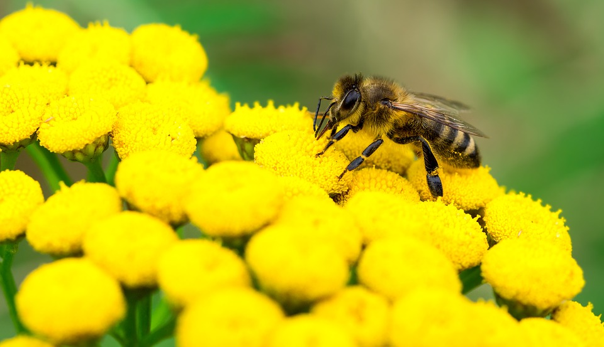
LET’S REVIEW!
Who can tell me what biodiversity is?
What happens when one or more organisms is removed from an ecosystem?
What is pollination?
Who can name a pollinator?
What are some things that threaten pollinators?
Notes:
Why is biodiversity important?
Why are pollinators important?

